Slide 1

The Role of Computers in Public Health

Slide 2

General Understanding
Computers in public health involve the application of digital technology for data collection, processing, and decision-making aimed at improving population health.
They serve as the backbone for managing large-scale health data, providing actionable insights for healthcare planning, response, and evaluation.

Slide 3
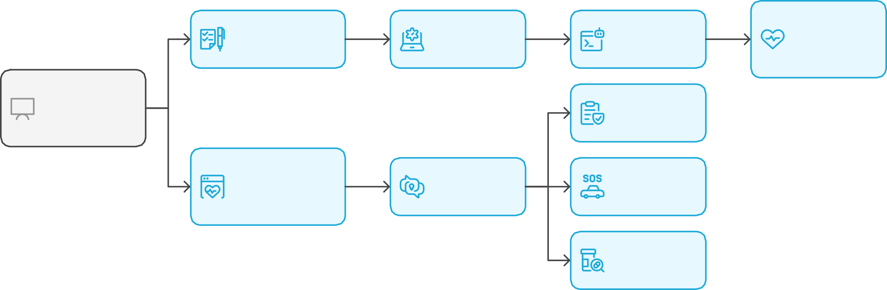
Role of Computers in Public Health
Data Collection
Data Processing
Decision- Making
Improved Population Health
Application of Digital Technology
Healthcare Planning
Management of Health Data
Actionable Insights
Healthcare Response
Healthcare Evaluation

Slide 4

Health Informatics in Public Health
Health informatics is the study and application of methods to collect, store, and analyze health data for improved healthcare delivery and outcomes.
Applications:
Real-time data access and monitoring.
Streamlined communication across health departments.
Automation of repetitive administrative tasks, allowing better resource allocation.

Slide 5
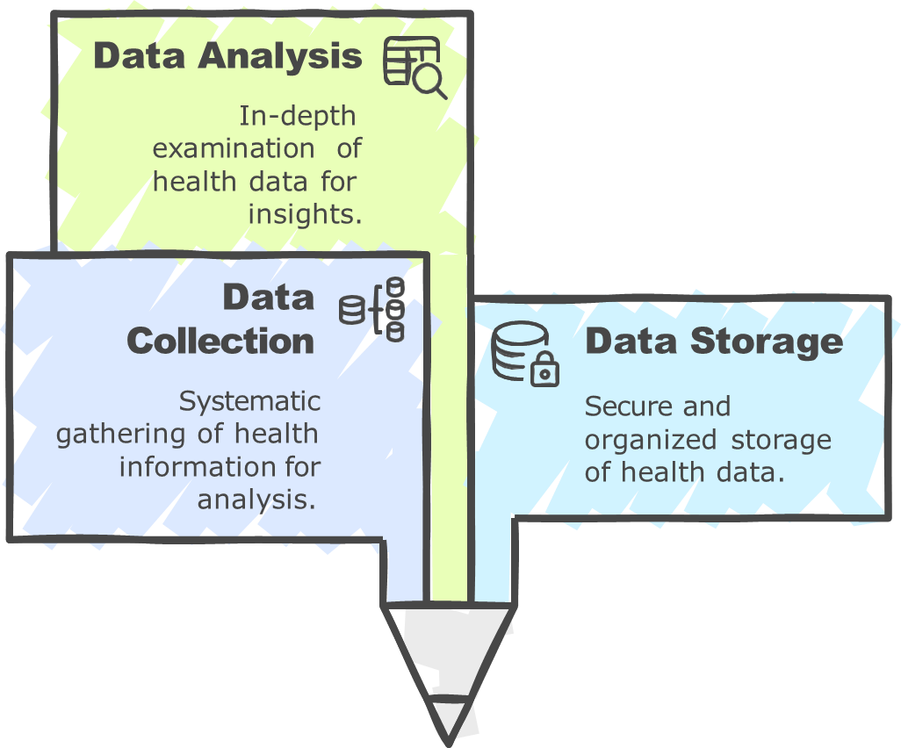
Unified Health Informatics

Slide 6
Disease Surveillance using Computers
Automated data acquisition from hospitals and laboratories into central surveillance platforms.
Use of GIS and mapping tools for real-time outbreak visualization (e.g., malaria, dengue).
Examples: Integrated Disease Surveillance Programme (IDSP), ProMED, and SORMAS.
Electronic Health Records (EHRs) for patient-level data integration.
Interoperable public health registries for vaccination, TB, HIV, and NCDs.
Decision support systems and dashboards for policy-makers.

Slide 7
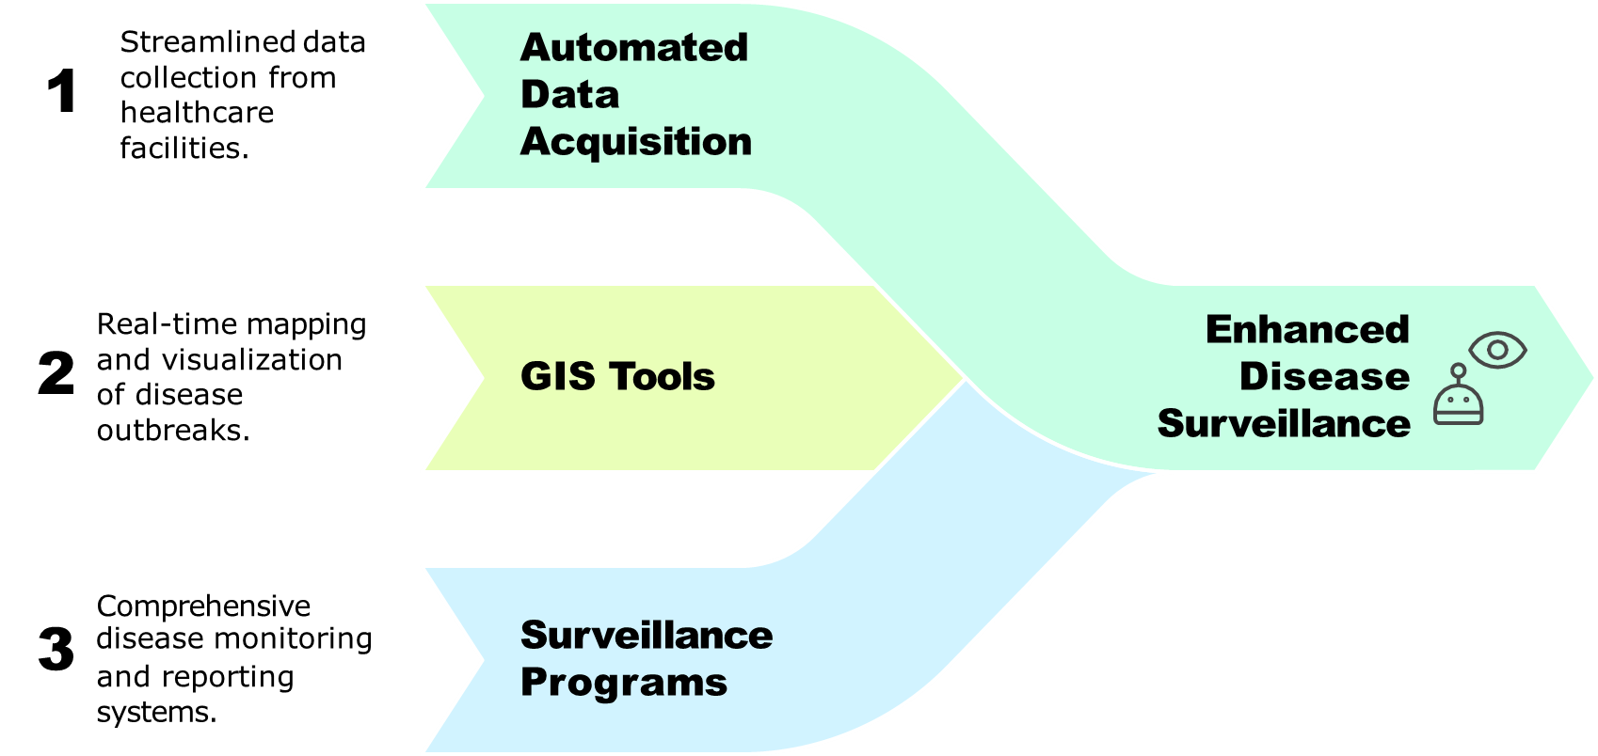
Integrating Technology for Public Health

Slide 8
Telemedicine and E-health
E-health uses computer networks for remote health service delivery, especially to underserved areas.

Slide 9
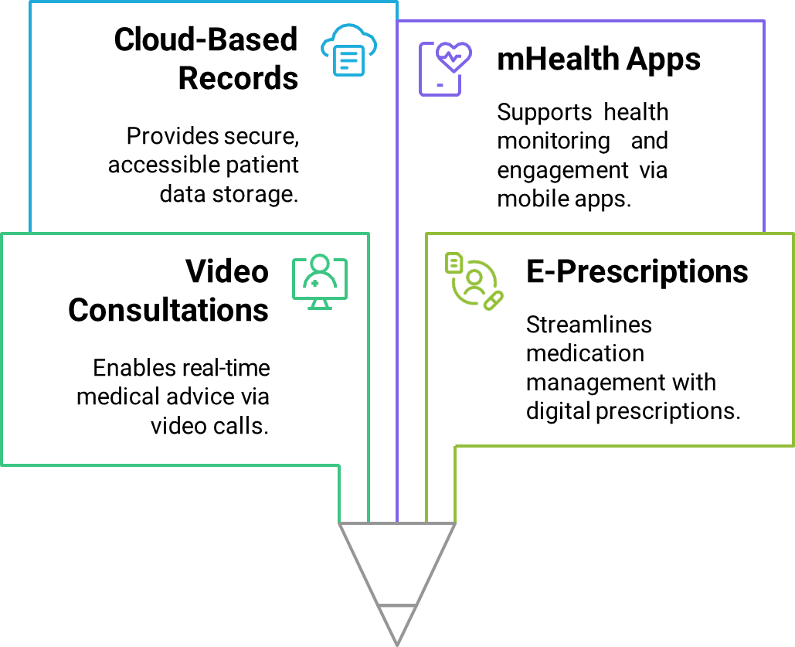
Telemedicine Platforms in E-Health

Slide 10








Role of Software Applications in Enhancing Efficiency
Identify Tasks
Select Software
Productivity Applications
Communication Tools
Design Software
Data Analysis Tools
Enhanced Efficiency
Improved Collaboration

Slide 11
Software available:
Epi Info by CDC for field data analysis.
R and Python for statistical modeling and machine learning.
SPSS, STATA, and SAS for structured health surveys and regression models.
DHIS2 for health information system management at national levels.

Slide 12
Disease Modeling and Prediction
Computers allow simulation of disease transmission using models like SEIR and agent-based models.
Real-time forecasting of outbreaks using ML algorithms.
Tools: GLEAMviz for pandemic simulations, HealthMap for outbreak alerting.

Slide 13
Role of Computers in Disease Modeling and Prediction
GLEAMviz Tool
Start: Disease Transmission Simulation
SEIR Models
Real-Time Outbreak Forecasting
Machine Learning Algorithms
Agent-Based Models
HealthMap Tool

Slide 14
Challenges in Developing Countries
Infrastructural limitations: internet, power, and hardware issues.
Fragmented data systems with poor interoperability.
Sustainability concerns and reliance on donor-funded platforms.
Lack of trained personnel for managing digital systems.

Slide 15
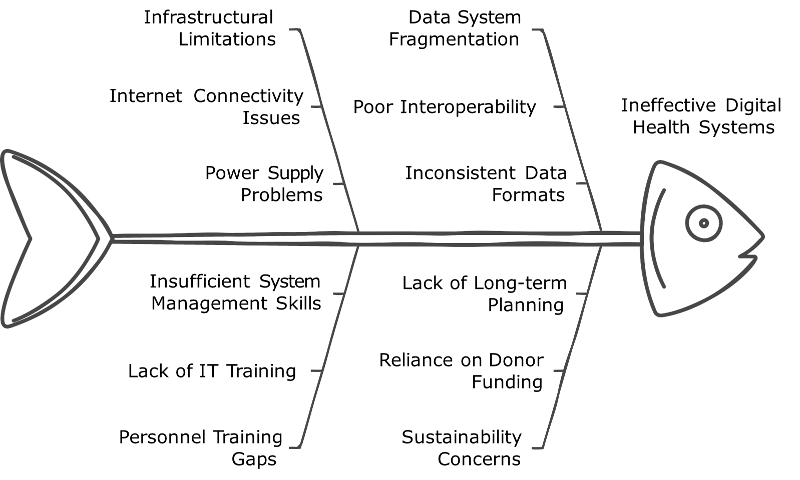
Challenges in Digital Health Infrastructure

Slide 16
Ethical Issues in Health Informatics
Patient data privacy and cybersecurity risks.
Challenges in obtaining informed consent for secondary data usage.
Regulatory frameworks often lag behind technology adoption.
Bias in AI models affecting decision fairness.

Slide 17
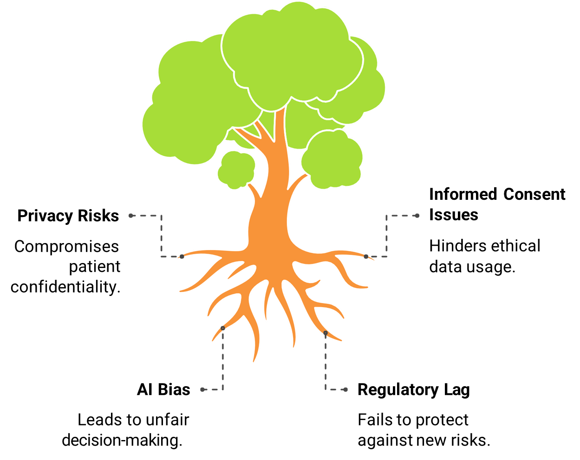
Data Privacy and Ethical Challenges in Health Informatics

Slide 18
Public Engagement via Digital Platforms
Social media and digital media campaigns raise awareness and encourage healthy behaviors.
Interactive government portals and mobile apps provide accessible health information.
Examples: Aarogya Setu app, WHO’s Digital Health Atlas.

Slide 19
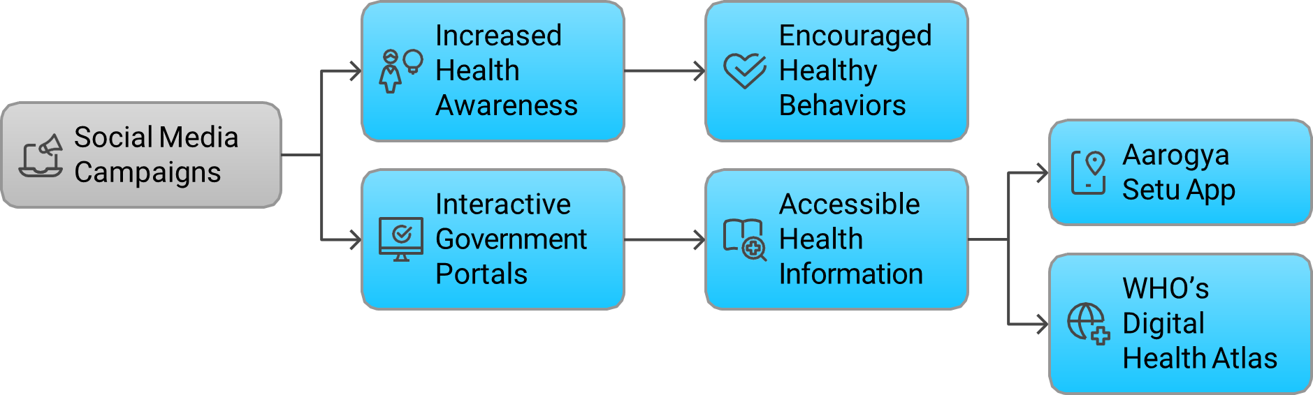
Enhancing Public Health through Digital Platforms

Slide 20
Computers During Pandemics
Used for real-time data tracking, visualization dashboards, and policy planning (e.g., COVID-19).
Contact tracing apps, mobility tracking, and hotspot identification.
Enabling rapid dissemination of protocols and advisories through digital platforms.

Slide 21
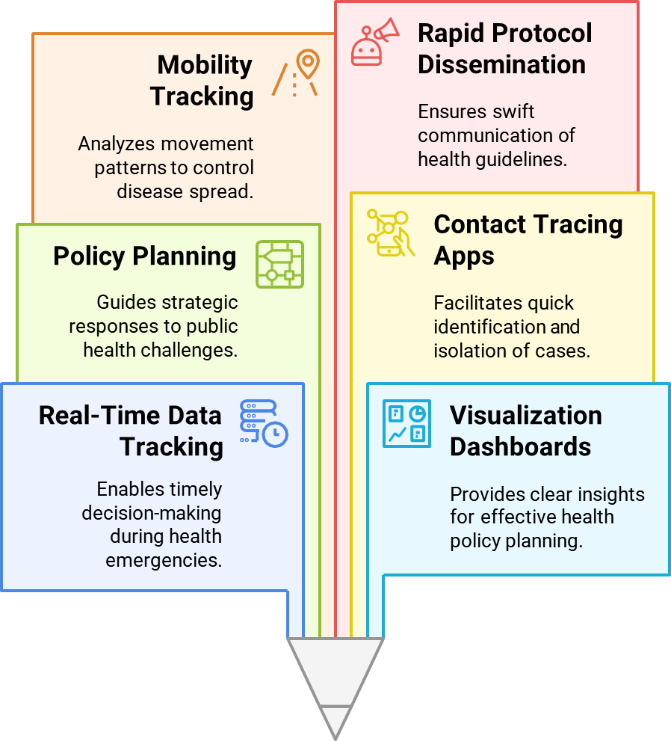
Digital Tools in Public Health

Slide 22

Future of AI & ML in Public Health
AI for predictive analytics: forecasting outbreaks, identifying high-risk populations.
ML-based diagnostics and image recognition (e.g., TB on chest X-rays).
AI-driven chatbots and virtual assistants for health triage.
Global Impact of Advanced Computer Technologies
Remote sensing and satellite imagery for environmental health surveillance.
Blockchain for secure health data sharing.
IoT integration for real-time monitoring of air quality, water safety, and patient vitals.
Digital twins for simulating population-level interventions.

Slide 23
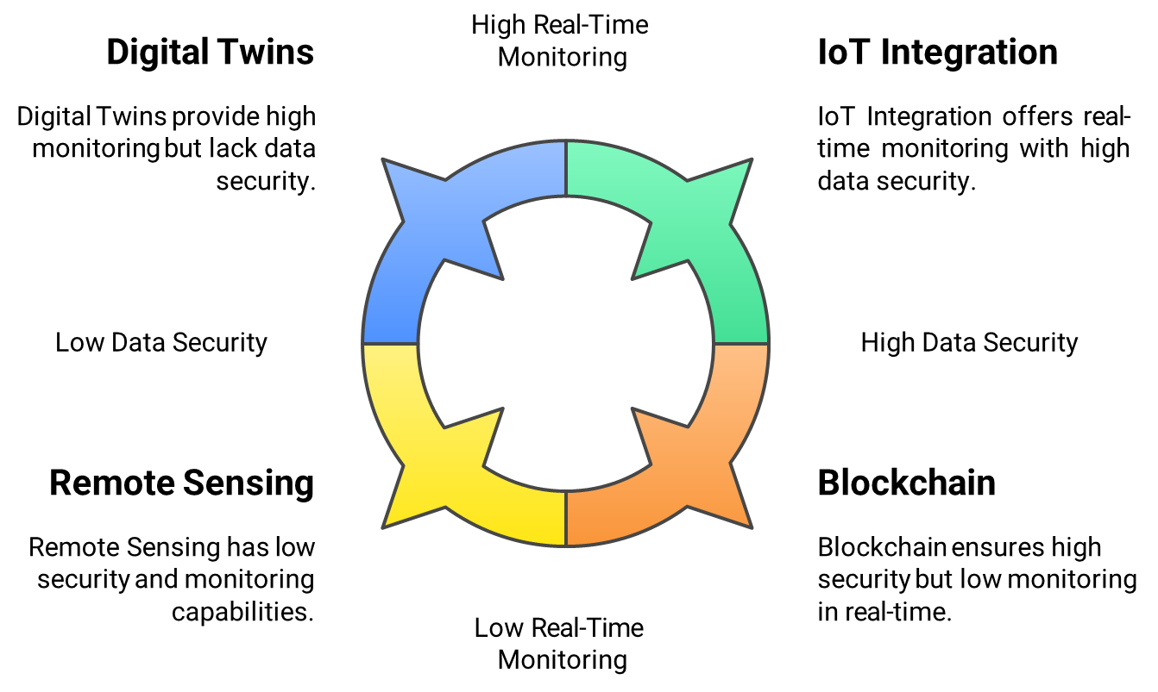
Technological Innovations in Public Health

Slide 24
Conclusion
Computers are central to the transformation of public health in the digital era.
From surveillance and diagnostics to awareness and forecasting, they offer unparalleled reach and precision.
A future-ready public health workforce must be trained in digital health technologies.

Slide 25

Thanks

